Slide 1
Cyclistic – Data Analysis
Akshay D

Slide 2
Agenda
Business overview 3
Available Data & Data Pre-processing 4
Insights 6
Recommendations 12

Slide 3
Business overview
Cyclistic is a bike sharing company launched in 2016. It is based in Chicago with over 692 stations and 5824 bikes.
Cyclistic has two types of customers.
Casual riders - Customers who purchase single-ride or full-day passes
Members - Customers who purchase annual memberships
Cyclistic wants to identify the difference between casual riders and members and areas to focus on to increase revenue.

Slide 4
Available Data & Data pre-processing
4

Slide 5
Available Data & Data Pre-processing
Data:
12 months of data starting from January till December of 2022.
The dataset contains information like type of bike rented, ride start time, ride end time, starting station name, starting station latitude, starting station longitude, ending station name, ending station latitude, ending station longitude.
Pre-processing steps taken:
Pre-processing was done using R-Programming
Extracted day of the week, month and hour of the day from the data.
Calculated the duration of each trip using the start time and end time.

Slide 6
Insights
6

Slide 7
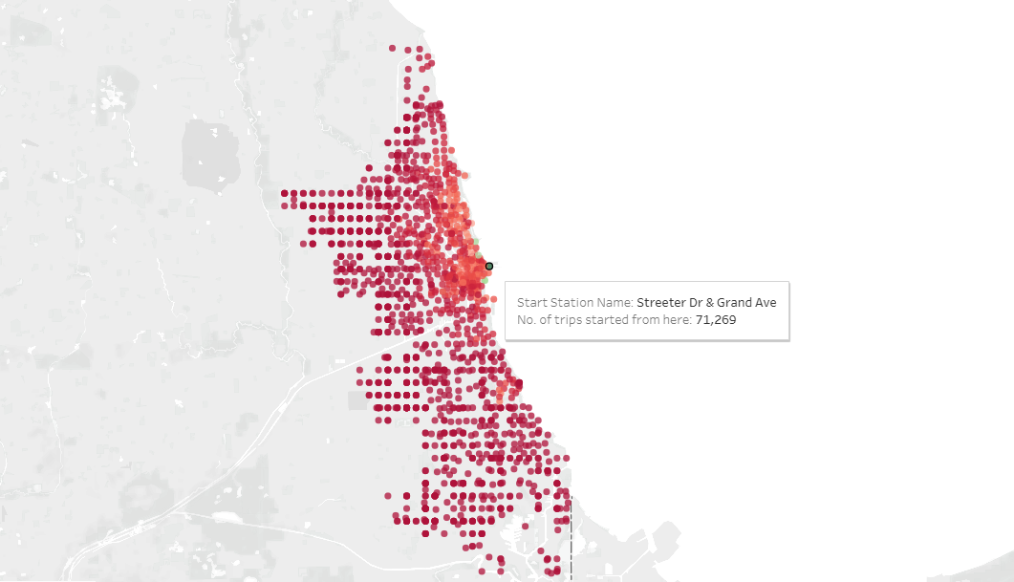

Geographic insights
Streeter Dr & Grand avenue is the most used station, followed by DuSable lake shore Dr and Monroe St and DuSable lake shore Dr & North Blvd
Electric bikes are generally used for long distance commute followed by classic bikes and docked bikes respectively.
Docked bikes are generally used for short distance travel.

Slide 8
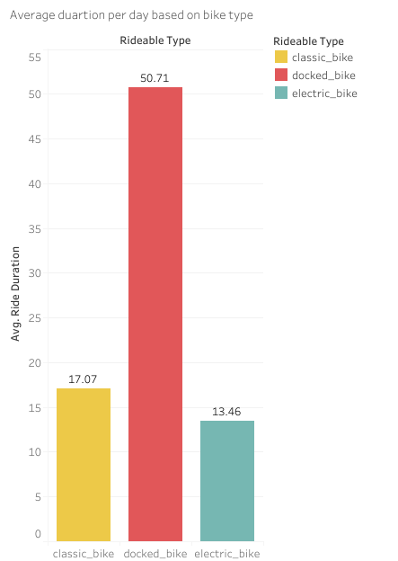
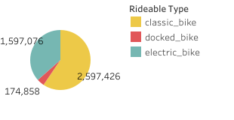
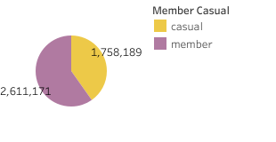
General statistics
Classic bikes are preferred more when compared to electric bikes and docked bikes.
Despite being the least rented, docked bikes are ridden for a longer duration on average.
Majority of Cyclistic’s customers are members.

Slide 9
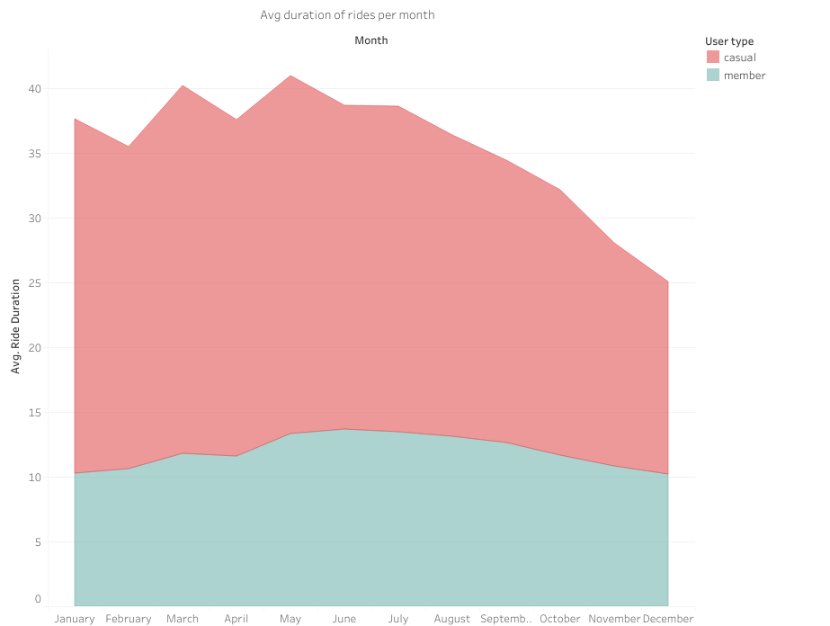
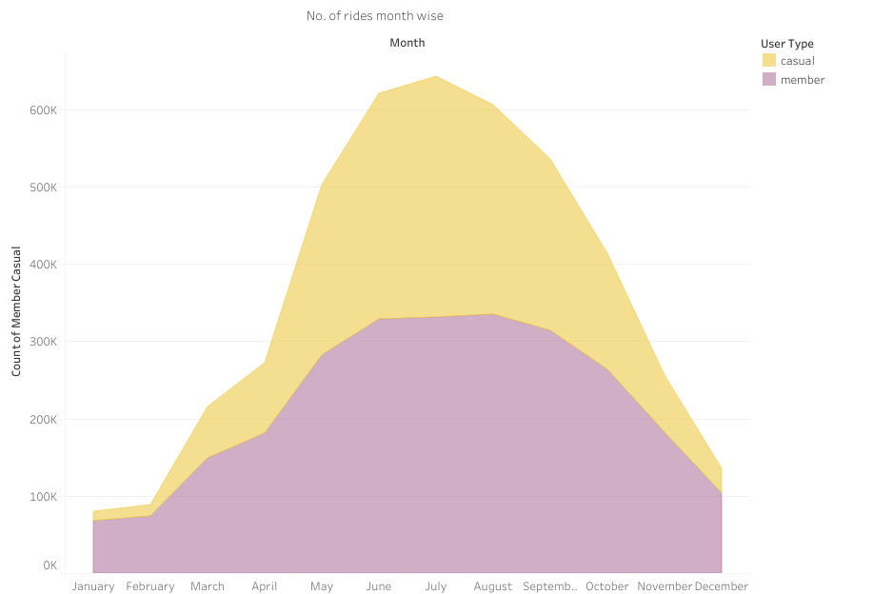
Monthly Analysis
Casual riders use the bikes for a longer duration compared to members.
The number of bikes rented takes a dip starting from december to march. This maybe due to the fact that these are winter months in Chicago.

Slide 10
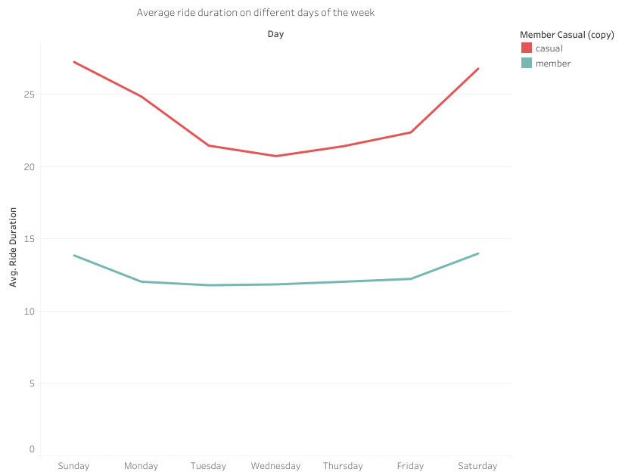
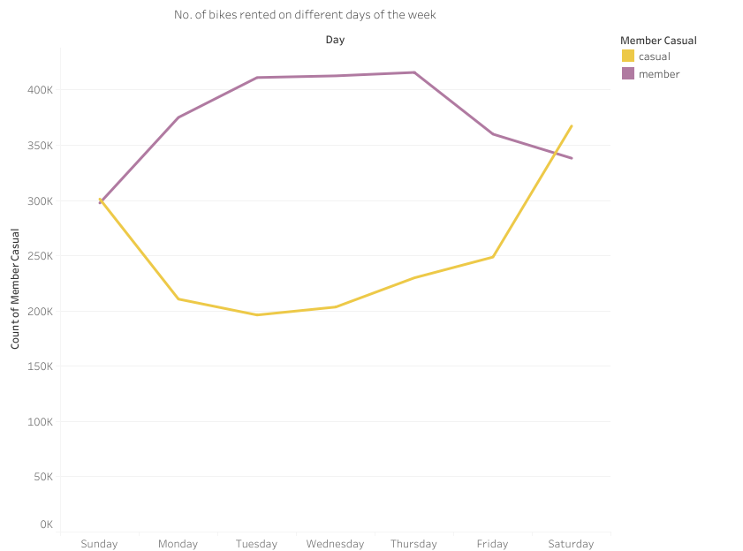
Weekly Analysis
Bikes are ridden for a longer duration on average during weekends when compared to weekdays.
More members rent bikes during weekdays when compared to weekends.
More casual users rent bikes during weekends when compared to weekdays.

Slide 11
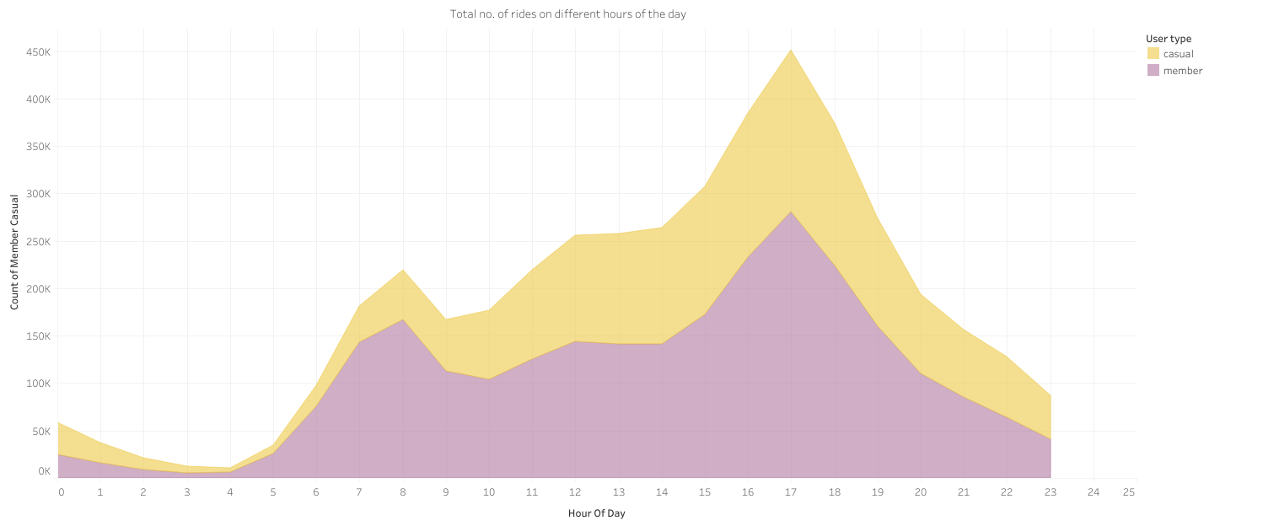
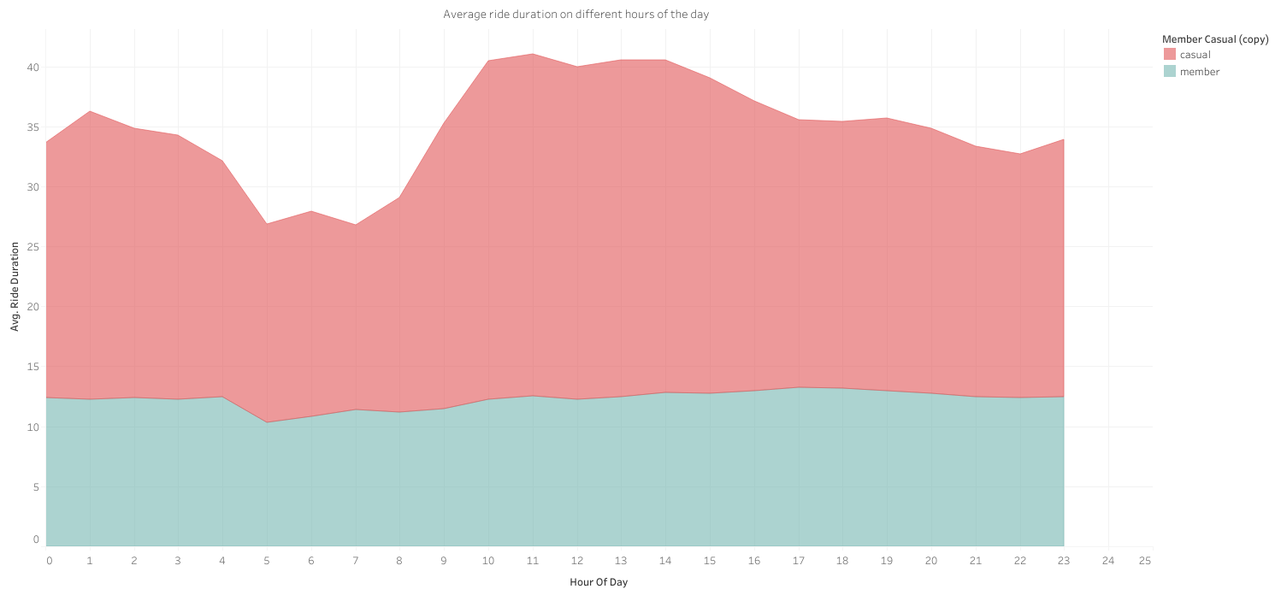
Hour of Day Analysis
The average ride duration is the lowest for casual riders between 5:00 am and 9:00 am.
Most number of bikes are rented between 6:00 am and 10:00 pm.
Most members rent bikes between 7:00 am and 7:00 pm.

Slide 12
Recommendations
Marketing Campaigns should be focused on the casual riders, with increased focus on Saturdays and Sundays.
Since casual riders take longer rides, thereby spending more per ride in the process, campaign should show financial advantages of being a paid subscriber.
Budget for docked bike development should be reduced since it is the least used and is generally used for short distances.
Maintenance of bikes and stations can be scheduled in the months between December and March, since the number of bikes rented is less during these winter months.

Slide 13
Links to project:
GitHub – https://github.com/AkshayDhamodaran/Cyclistic-Data-Analysis
Tableau Dashboard - https://public.tableau.com/app/profile/akshay.d7457/viz/Divvycycledata/Dashboard1#1

